Slide 1
SPEAKING Part 1: short questions (3 – 4 topics) Part 2: long turn (1 topic in 2 minutes) Part 3: Topic-related questions

Slide 2
SPEAKING QUESTIONS PART 1 Hometown – Family – Work – Study YES – NO LIKE Wh-questions (What – Why – How often – When …) Would you like How often Tell me about

Slide 3
IELTS SPEAKING PART 1
A.R.E.A
A: Answer
R: Reason
E: Example
A: Assumption

Slide 4
1. Answer → Reason → Example → Assumption 2. Answer → Reason 1 → Reason 2 3. Answer → Reason → Future Would you like … ? Well, I have never thought of that, but If I had a chance, I would (not) …

Slide 5
IELTS SPEAKING PART 1
A: Answer
Paraphrase the question and answer.
Well,
Actually,
From my perspective, …
Well, to be honest…
Actually, to be fair…
To be totally upfront, = To be honest In all seriousness, Without a doubt,

Slide 6
How do you go to school? Well, I usually go/ travel/ commute to school by bus. What sport is popular in your country? From my perspective, football is probably the most popular sport.

Slide 7
IELTS SPEAKING PART 1
R: Reason
Give reason for your answer.
1. The reason is that …
2. Since, because …
3. As you know, ….
4. And the explanation for this could be that…
5. And the basis of this is that..
6. This is because …

Slide 8
Do you like buying accessories?
(Answer) Absolutely yes. (Reason) As you know, I am a girl and I want to look sharp with pretty accessories so you know, I really want to buy myself new shoes, hats or necklaces.

Slide 9
IELTS SPEAKING PART 1
E: Example
State an example for the answer.
Just give an example, …
For example, ….
A clear illustration is that …
To cite an example, …
To illustrate

Slide 10
(Answer) Actually I find myself not creative enough to be an inventor. (Reason) I don’t have a necessary amount of technical know-how and patience to go through a lot of trial and error. (Example) I would like to be a person who can enjoy the inventions rather than the one who can invent them.
Do you want to become an inventor in the future?

Slide 11
IELTS SPEAKING PART 1
A: Assumption
Give an opposite opinion on the answer .
However, I think in the future, … (future tense)
Nevertheless, (state an opposite side of the answer)

Slide 12
Do you like buying accessories?
(Answer) Absolutely yes. (Reason) As you know, I am a girl and I want to look sharp with pretty accessories so you know, I really want to buy myself new shoes, hats or necklaces. (Alternatives) However, I am not a slave of fashion and I only buy must-have items such as bags or some pairs of earrings Absolutely no. However, I usually buy pieces of clothes for my relatives. Absolutely no. However, I think I will buy some necessary clothes for my future need.

Slide 14
FOCUS ON FLUENCY & COHERENCE GIVE 2 – 3 SENTENCES
Statement
Answer the question with details
Explanation
Advantage
Reason
Specific description

Slide 15
1st sentence: Statement: Paraphrase and answer the question in your own way: To be honest – In my opinion, - To me, - Well, I suppose, - Honestly speaking, - Personally, I think … - If you ask me …
2nd sentence: Explanation - Disadvantage of feeling (negative) towards the pieces of information given in the statement
What I dislike about this is that …
What I’m unhappy about this is that …
The bad/ worst thing about it is that …
I don’t like football. What I dislike about this is that ….

Slide 16
2nd sentence: Explanation - Advantage of feeling (positive) towards the pieces of information given in the statement
What I like about this is that …
What I’m happy about this is that …
The good/ best thing about it is that …
How do you go to school? → I go to school by bus. What I like about this is that it is cheap, and I can save money to buy some snacks for lunch

Slide 17
2nd sentence: Explanation - Reason why you stated that pieces of information given in the statement
The reason is that …
It’s because …
Obviously …
Do you often play sports?
How often do you watch TV?

Slide 18
2nd sentence: Explanation - Description: describe the information stated in the statement in more detailed
What I mean is that …
What this means is that …
Truth is, …
In fact, …
Would you like to move to another country to live? → If I had a chance, I would … This is because it helps me + V nguyen mau
Can you repeat the question please? – Can you say again please?
Sorry can you repeat the question?
Can you speak a bit slowly please?

Slide 19
Work and Study
Hometown
Family
Yourself
House

Slide 20
3rd sentence: Opinion Opinion: Your opinion towards the matter stated Personally, I believe that/ I think that … To me, …. To be honest/ candid, …
It is highly recommended that you pick only one phrase (from each category) to study.

Slide 21
What sport do you like? Well, I really love basketball. The reason is that it helps me feel relaxed when I watch it. To be honest, I think I will try to play it in the future.

Slide 22
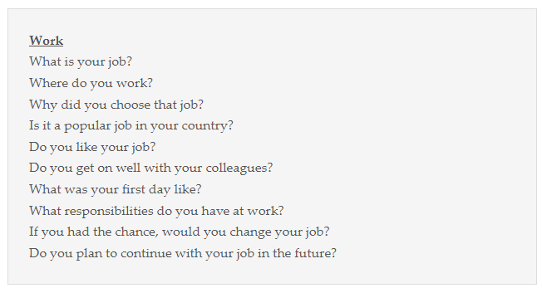

Slide 23
Part 2: Intro Well, this is such a difficult question, to be honest. I may come up with better ideas when given more time. Off the top of my head, I would say/ talk about ….

